Slide 1
Exam 1 Topics
David Quigley
CSCI 5622
2021 Fall

Slide 2
Classification – Weeks 1 – 7*
K Nearest Neighbors
Manhattan, Euclidian Distance
Naïve Bayes
Class-Conditional, Prior, Evidence
Trees & Ensemble Methods
Splitting, Pruning
Random Forests
AdaBoost
Logistic Regression
Idea, Proof, Implementation
Gradient Descent
Stochastic & Mini-Batch Gradient Descent
SVM
Idea, Proof, Implementation
Sequential Minimal Optimizer
Kernel Trick

Slide 3
Regression
Linear Regression
Idea, Proof, Implementation
Minimizing MSE / LSS

Slide 4
Dimensionality Reduction
Select-K-Best / Best Subset
Stepwise selection
Stagewise Selection
Lasso & Ridge Regression
Idea, Proof, Implementation
Within Linear Regression

Slide 5
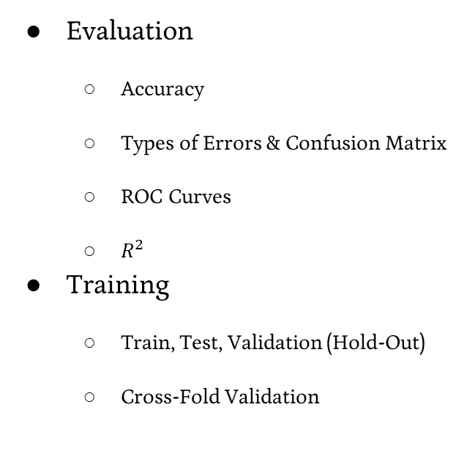
Skills
Evaluation
Accuracy
Types of Errors & Confusion Matrix
ROC Curves
$R^{2}$
Training
Train, Test, Validation (Hold-Out)
Cross-Fold Validation
Multi-Class
One vs. All
All-Pairs (One vs. Another)
Data Transformation
Encoding, Binning, Smoothing, Binarization / One-Hot Encoding, etc.
Scaling & Normalization
Min-Max, Mean & Std. Dev

Slide 6
Concerns
Impact of Errors
False Positive vs. False Negative
Overfitting
High Variance
Underfitting
High Bias
Curse of Dimensionality
When to use what classifiers?

Slide 7

Exam 1 - Logistics
Delivered via Canvas
Open on Oct. 20, Approximately all day
(Probably not 12:01AM to 11:59PM, but well beyond the class period, including morning through evening times)
It will be Timed to only allow you 50 minutes to complete
Those with 1.5X dispensation, etc. will be accommodated via Canvas.
Exam support will be provided in-lecture and via Zoom during lecture time.
A slightly longer window of support (i.e. to accommodate extra time students) will be via Zoom, timing TBD.

Slide 8

Exam 1 - Format
It is considered “open-resources”, but “individual”
Previous work, notes, Piazza discussions, textbook, etc. are all fair game
(Piazza will be in “read-only” mode for the day, so don’t be scared someone will post solutions there)
In general, follow the same plagiarism and honor code policies as any other assignment
Conceptual Questions
Closed-ended (multiple choice, matching, word bank, etc.)
Open-ended short answer with clear guidance (name one reason we would choose X over Y)
Problem Solving
Can be done with a 4-function calculator and some paper in a 50-minute exam
No coding or code analysis

